Slide 1


Exploring Elastic Container Service in
AWS

Slide 2
Definition of ECS: Elastic Container Service (ECS) is a fully managed service simplifying Docker container orchestration on AWS.
AWS Integration: ECS integrates seamlessly with AWS infrastructure, enhancing resource management through native compatibility and services.
Scalability Features: ECS automatically scales applications, supporting fluctuating workloads efficiently in microservices-based
Exploring Elastic Container Service in
AWS

Slide 3
ECS
ELASTIC
CONATINER
SERVICE
KEY FEATURES OF (ECS) Overview
Definition of ECS: Elastic Container Service (ECS) is a fully managed service simplifying Docker container orchestration on AWS.
AWS Integration: ECS integrates seamlessly with AWS infrastructure, enhancing resource management through native compatibility and services.
Scalability Features: ECS automatically scales applications, supporting fluctuating workloads efficiently in microservices-based
Container Orchestration: ECS streamlines container orchestration by automating deployment, management, scaling, and network configuration for services.
Service Discovery: Built-in service discovery facilitates automatic registration and discovery of services, improving microservices communication resiliency.
Load Balancing: ECS provides robust load balancing solutions, distributing incoming traffic across containers to ensure high availability.
Key Benefits of Using ECS in AWS

Slide 4
.
KEY FEATURES OF (ECS) Overview
Container Orchestration: ECS streamlines container orchestration by automating deployment, management, scaling, and network configuration for services.
Service Discovery: Built-in service discovery facilitates automatic registration and discovery of services, improving microservices communication resiliency.
Load Balancing: ECS provides robust load balancing solutions, distributing incoming traffic across containers to ensure high availability.
ECS Architecture Overview: The ECS architecture comprises clusters, task definitions, services, and containers, working cohesively within AWS.
Cluster Configuration: Clusters consist of resources for running tasks, acting as a pool for resource management in ECS.
Task Definitions Role: Task definitions specify parameters for container launching including images, CPU, memory, and networking settings.
Architecture Overview
Key Benefits of Using ECS in AWS

Slide 5



Architecture Overview
Automated Deployments
Auto Scaling
ECS Architecture Overview: The ECS architecture comprises clusters, task definitions, services, and containers, working cohesively within AWS.
Cluster Configuration: Clusters consist of resources for running tasks, acting as a pool for resource management in ECS.
Task Definitions Role: Task definitions specify parameters for container launching including images, CPU, memory, and networking settings.
Use tools like AWS CodePipeline to automate deployments.
Scale your applications automatically based on demand.
Deployment and Scaling with ECS
Rolling Updates
Update applications seamlessly without downtime.

Slide 6
Deployment and Scaling with ECS
Amazon S3 for storage.
Amazon ECS Integration with other AWS Services
Amazon DynamoDB for NoSQL databases.
Automated Deployments
Auto Scaling
Use tools like AWS CodePipeline to automate deployments.
Scale your applications automatically based on demand.
Amazon RDS for relational databases.
AWS Lambda for serverless functions.
Rolling Updates
AWS CloudWatch for monitoring and logging.
Update applications seamlessly without downtime.

Slide 7

.
Use a Container Image Registry
Amazon S3 for storage.
1
Store and manage container images.
Amazon ECS Integration with other AWS Services
Amazon DynamoDB for NoSQL databases.
2
Define Resource Limits
Set memory and CPU limits for containers.
Amazon RDS for relational databases.
3
Enable Logging and Monitoring
AWS Lambda for serverless functions.
Track container health and performance.
4
AWS CloudWatch for monitoring and logging.
Implement Security Best Practices
5
Secure your containers and the underlying infrastructure.

Slide 8


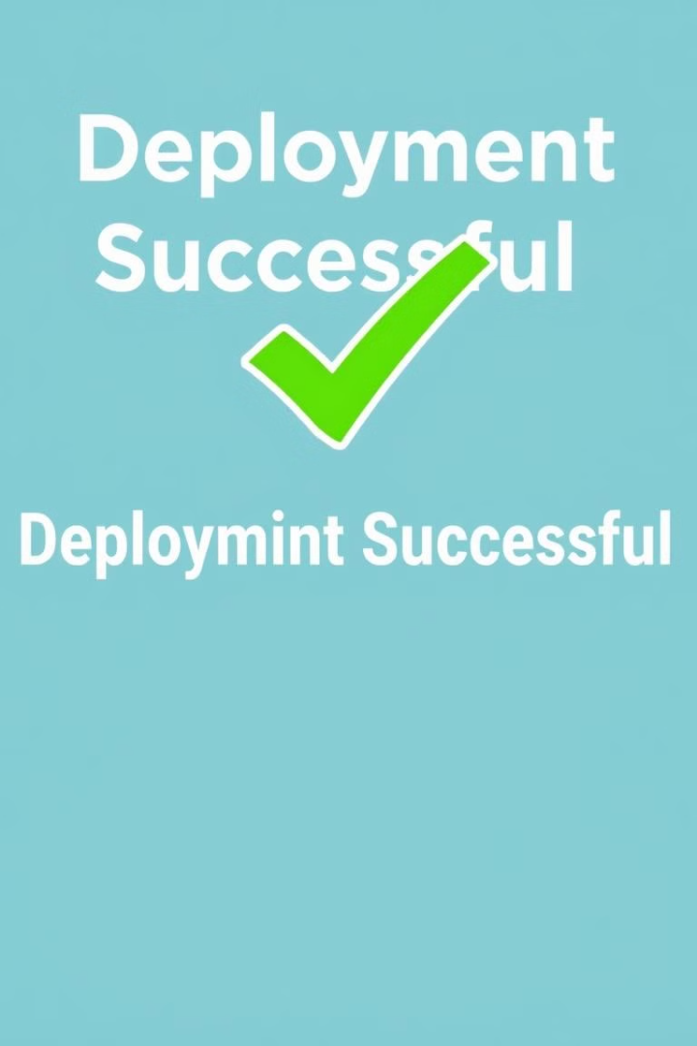


.
Use a Container Image Registry
1
2
Store and manage container images.
Best Practices for Running Containers
on ECS
Conclusion and Key Takeaways
Powerful Orchestration
Enhanced Scalability
Define Resource Limits
Effortlessly manage your containerized applications.
Scale your applications up or down as needed.
Set memory and CPU limits for containers.
Enable Logging and Monitoring
3
4
Track container health and performance.
Cost-Effective
Integration with AWS Ecosystem
Implement Security Best Practices
Pay only for the resources you use.
Secure your containers and the underlying infrastructure.
Leverage a wide range of AWS services.

Slide 9

.
1
2
Conclusion and Key Takeaways
Powerful Orchestration
Enhanced Scalability
Effortlessly manage your containerized applications.
Scale your applications up or down as needed.
3
4
Cost-Effective
Integration with AWS Ecosystem
Pay only for the resources you use.
Leverage a wide range of AWS services.
Thank you….🫱🏻‍🫲🏻

Slide 10
Thank you….🫱🏻‍🫲🏻

